Slide 1

Popping shells with your cereal box
Michael West
T3h Ub3r K1tten
Colin Campbell
magicspacekiwi

Slide 2
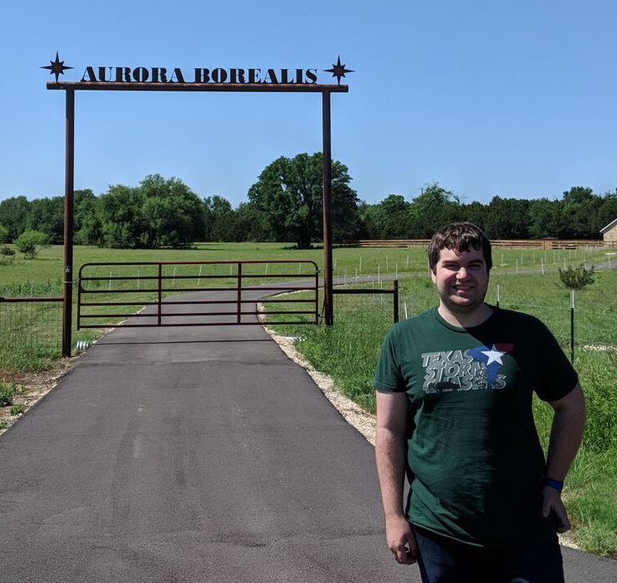
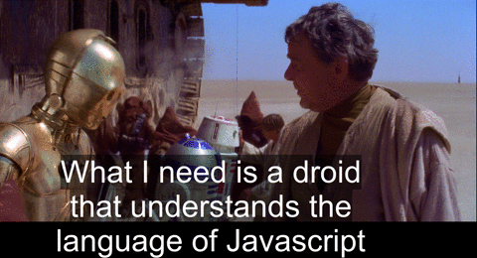

humans.txt
Michael West
magicspacekiwi
Enjoys scanning long barcodes on the beach
Professional internet tube filler "Master of the web"

Slide 3
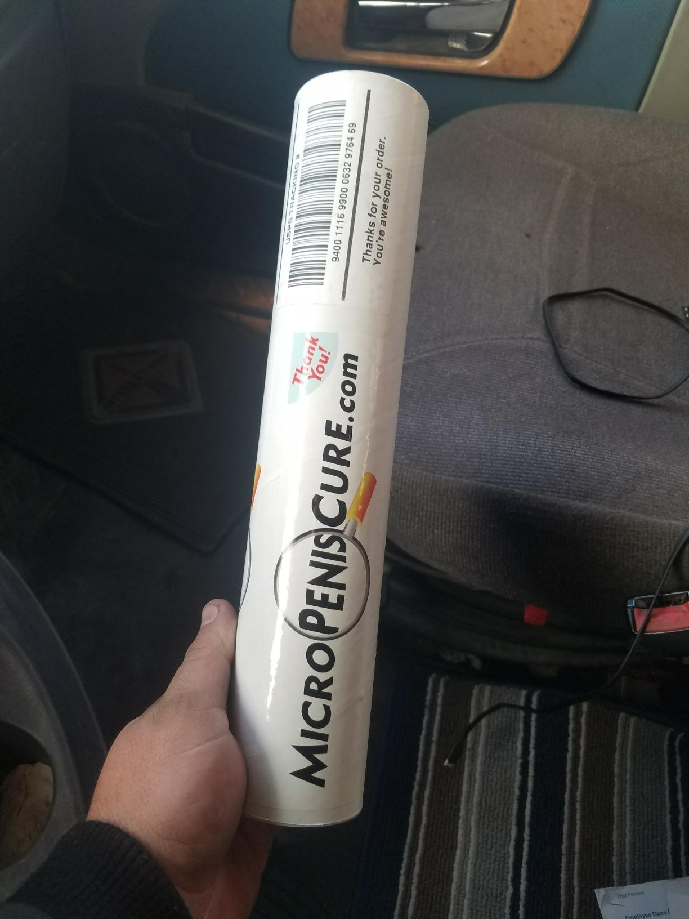
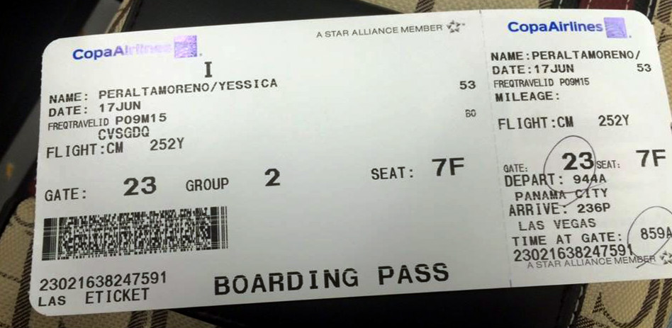


Barcodes are everywhere
Notes:
Shipping label, boarding pass, UPC on product

Slide 4
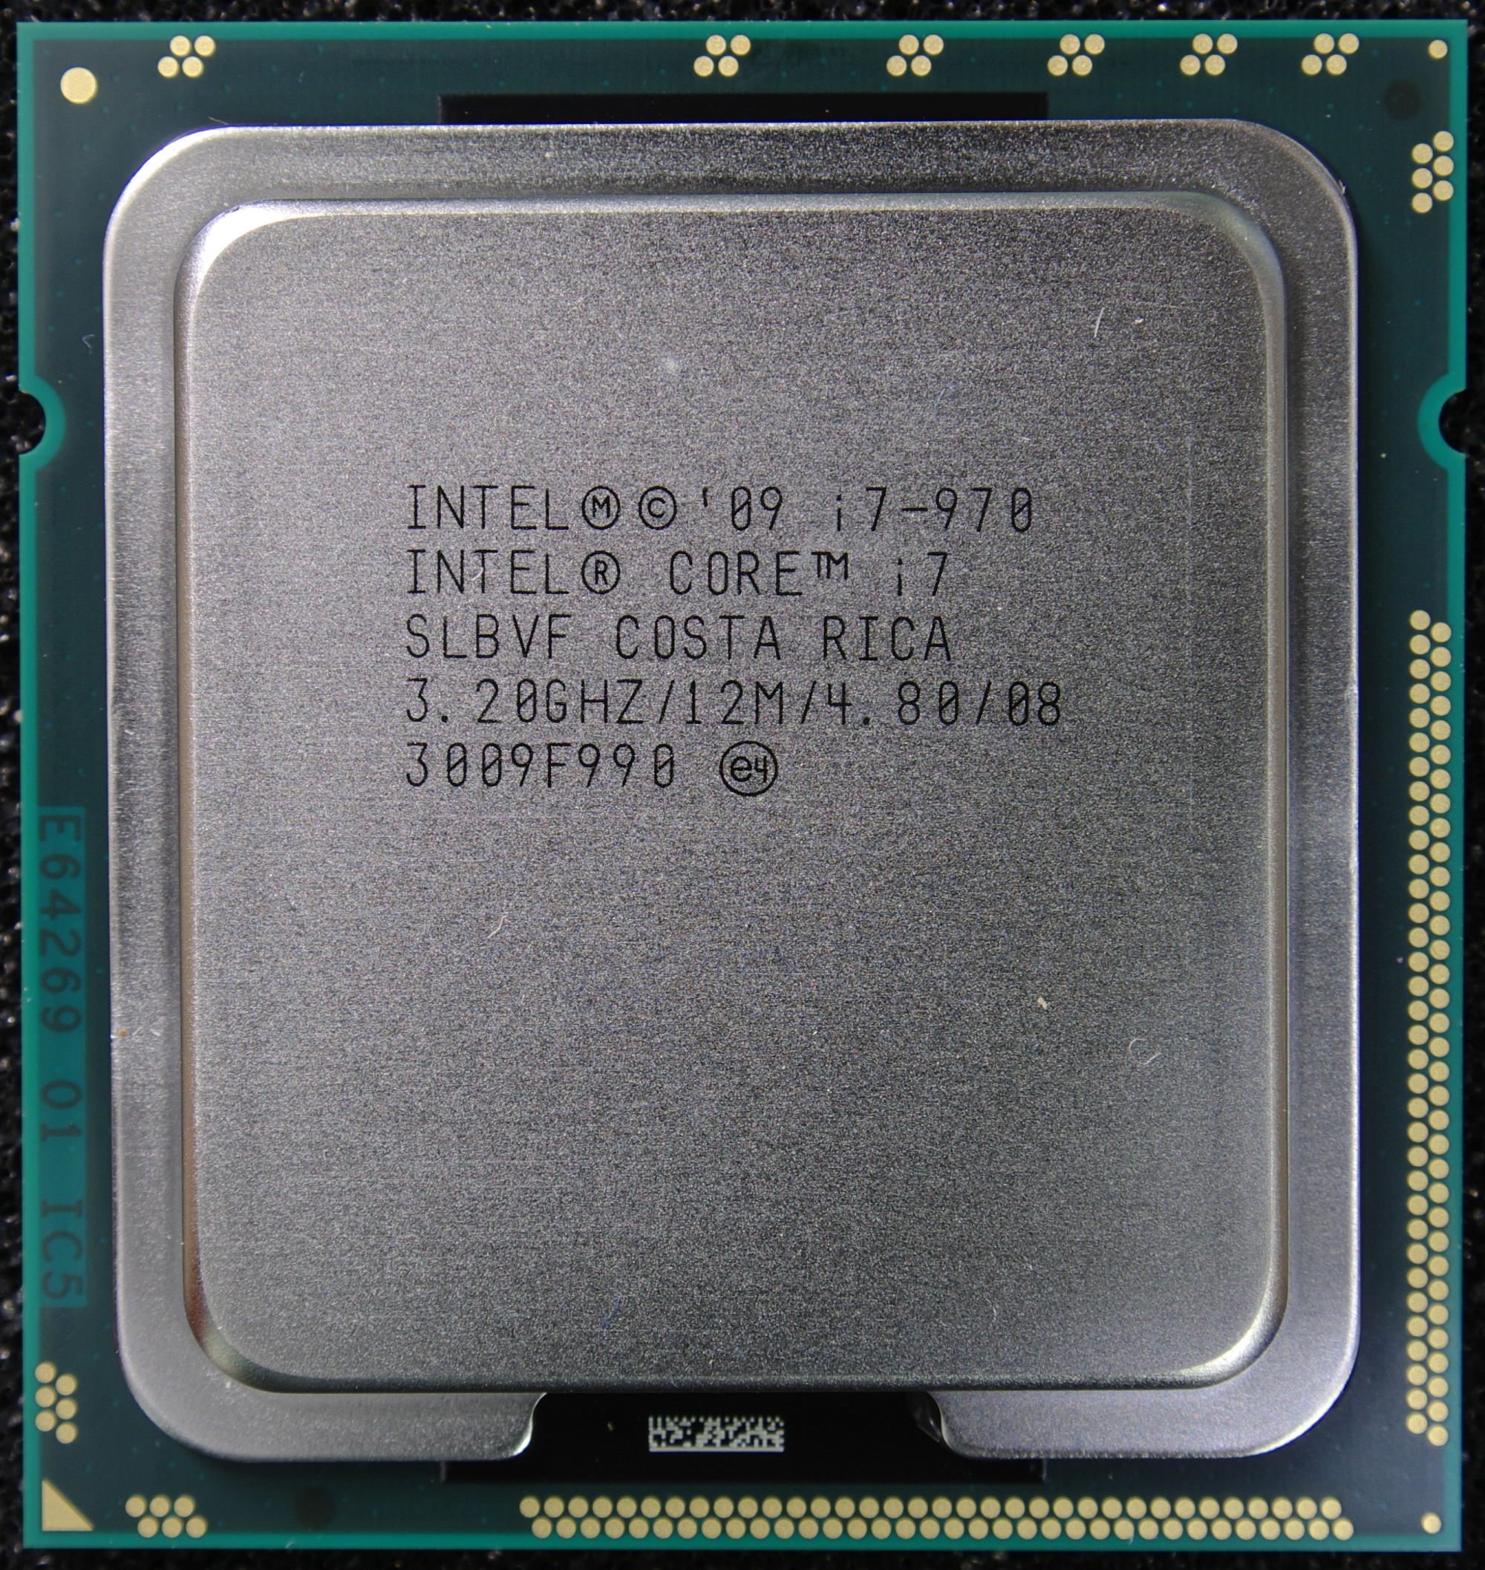
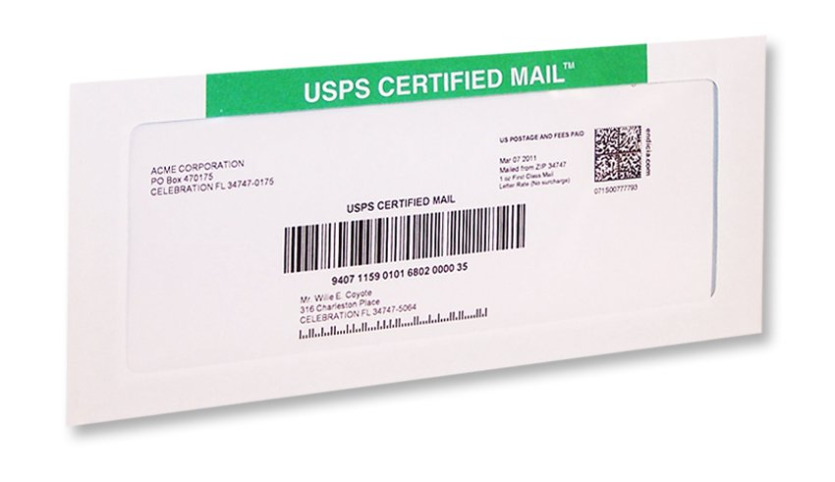
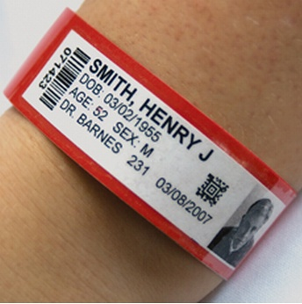
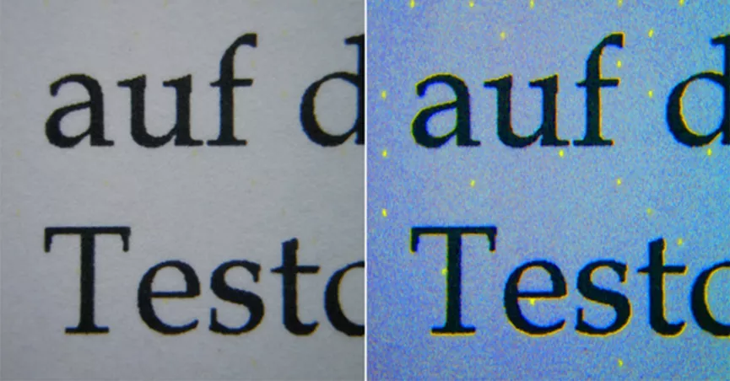
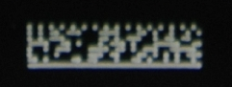
Barcodes are everywhere
Notes:
Less common: Part identification, hospital wristbands, usps mail

Slide 5
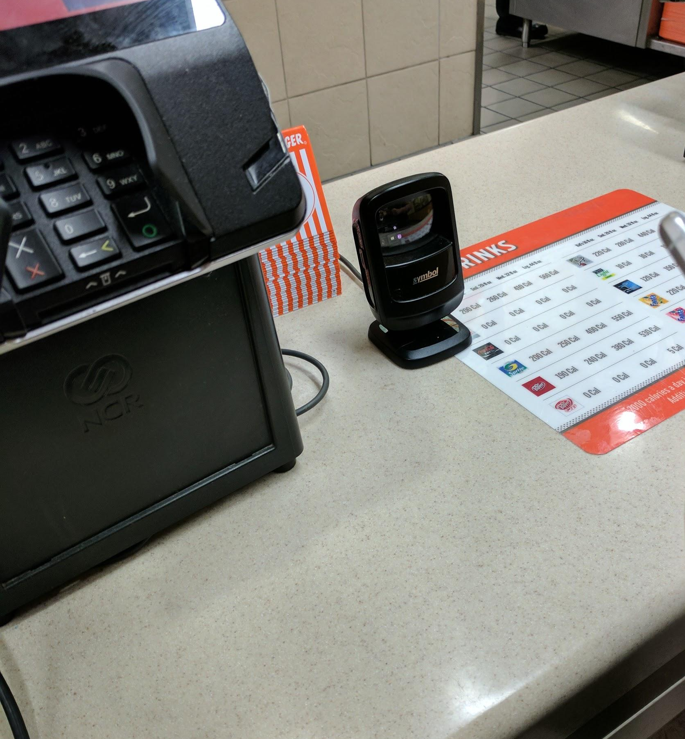
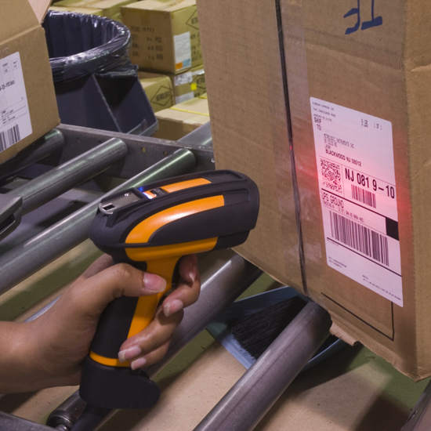
Barcode scanners are everywhere

Slide 6



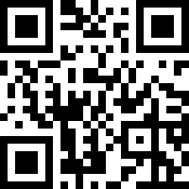

Barcodes usually decode to text
Code 128
QR
Aztec
PDF417
UPC
Did you ever hear the tragedy of Darth Plagueis "the wise"? I thought not. It's not a story the Jedi would tell you. It's a Sith legend. Darth Plagueis was a Dark Lord of the Sith, so powerful and so wise he could use the Force to influence the midichlorians to create life... He had such a knowledge of the dark side that he could even keep the ones he cared about from dying. The dark side of the Force is a pathway to many abilities some consider to be unnatural.
barcOwned
barcOwned
02626260
https://038000144158.pw/
Notes:
Each of these is called a symbology
Barcodes come in various densities

Slide 7
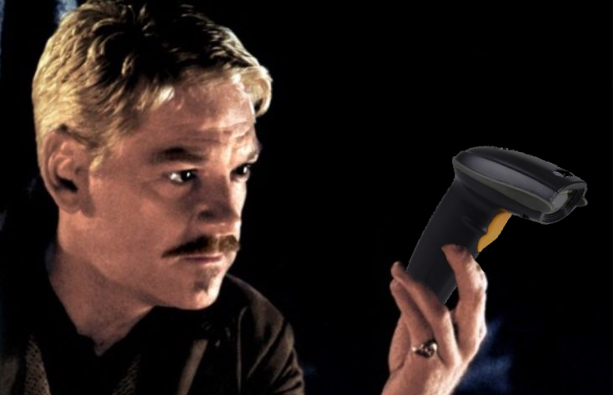
Scanner soliloquy
Scanners are mostly the same
Most common (default) mode:
Act as HID keyboard
Type buffer key by key
What could we do if we could
Change the text on the fly?
Send arbitrary keystrokes?
Win + R?
To scan, or not to scan...

Slide 8
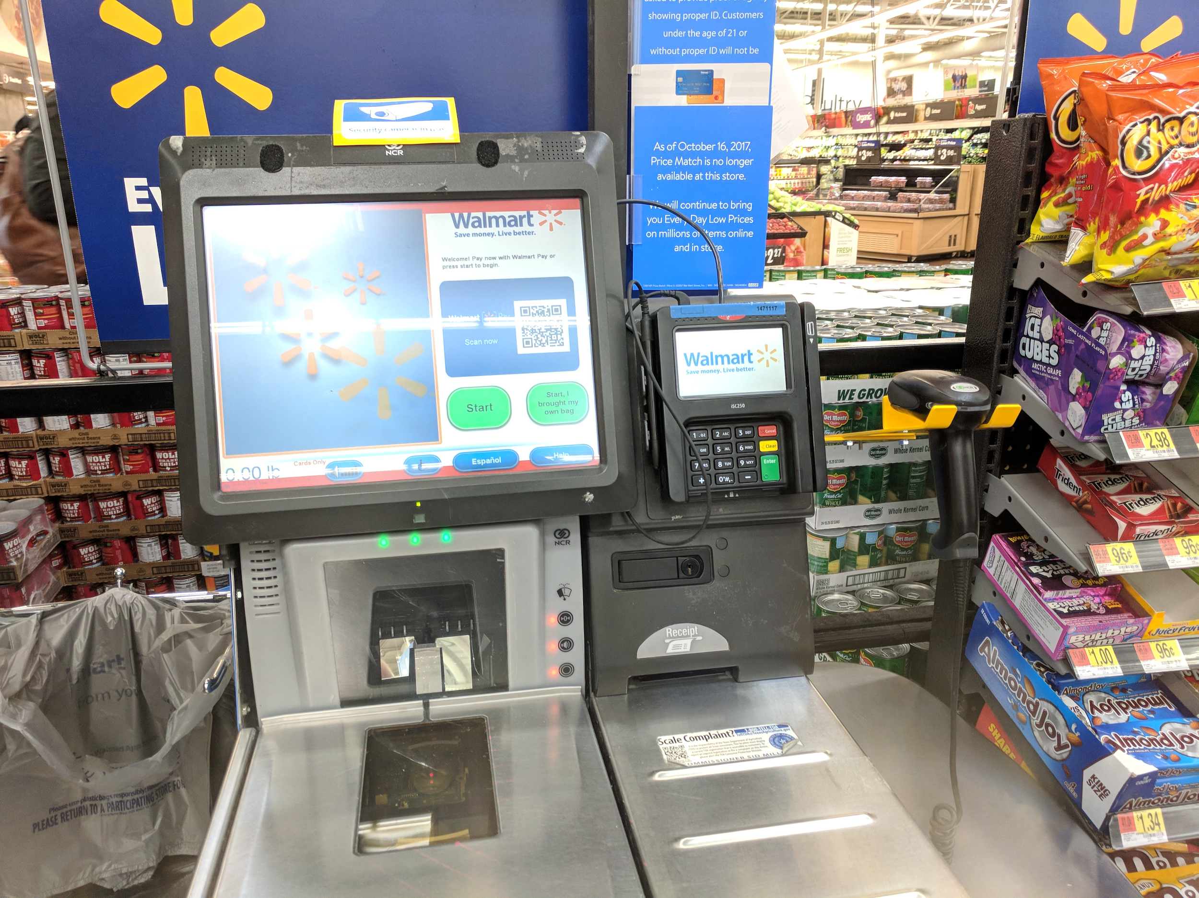

What could we do?*
*with proper permission in the scope of a legal, sanctioned pentest

Slide 9

It's not a bug!™
Some symbologies add control chars
Code 128:
107 possible characters
0 - 95: portions of ASCII
96-106: control chars
Control chars trigger programming
Majority of scanners support this
Manufacturer specific
FNC3
10111100010
Index: 96

Slide 10
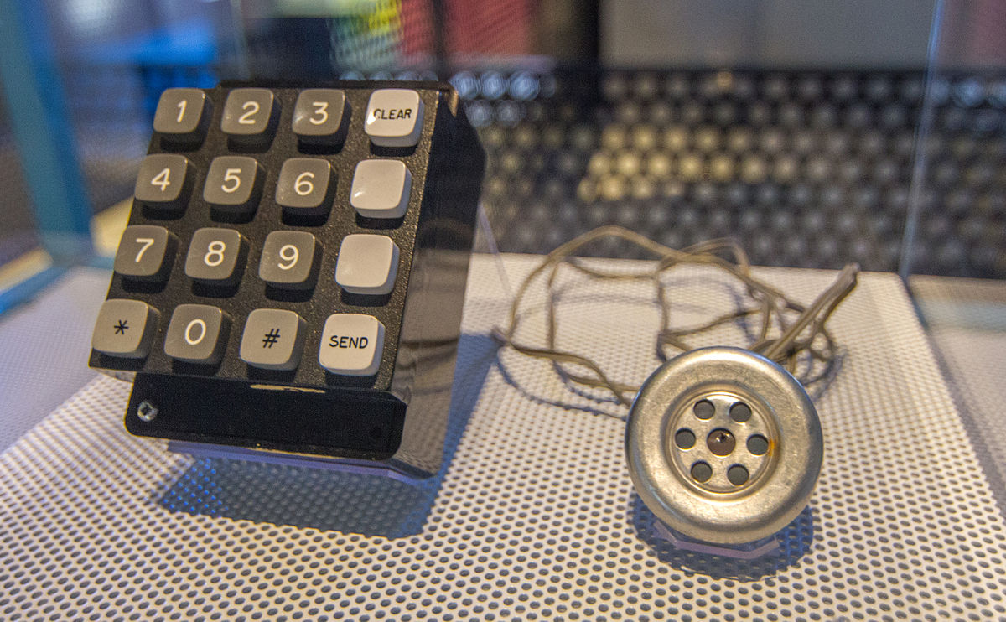
Yes, it's in-band signaling

Slide 11
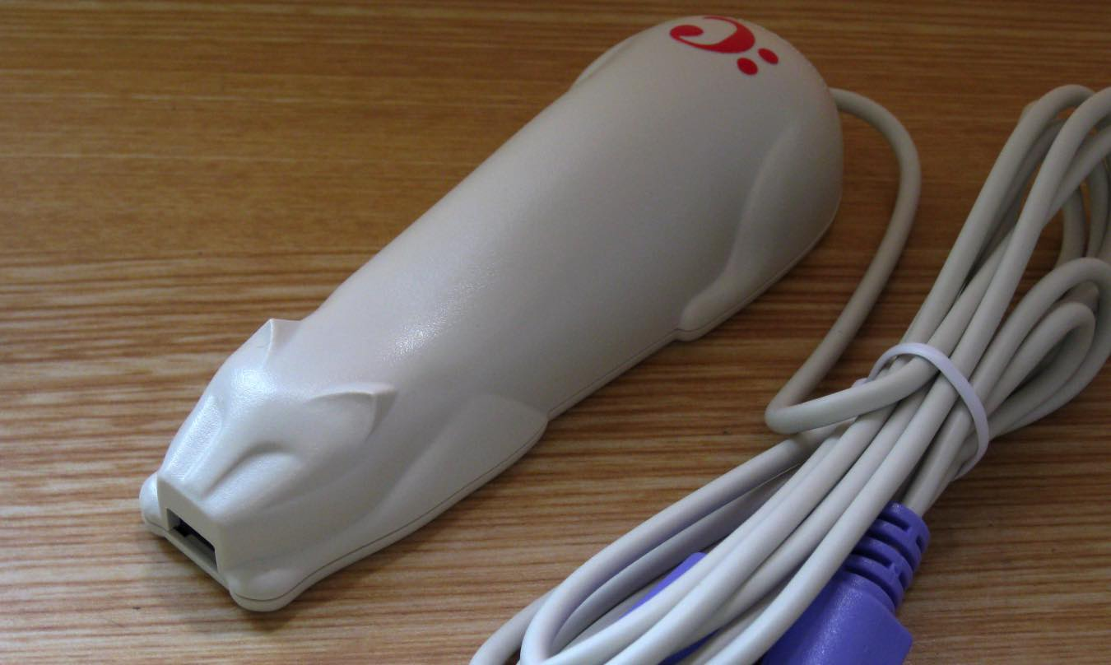
What can programming do?
Exists for legacy systems
"We use Cyberdyne to track and herd our cats."
"It's too expensive to replace or modify."
"Make it faster!"
Real (fake) example
No, not THAT type of cat...

Slide 12
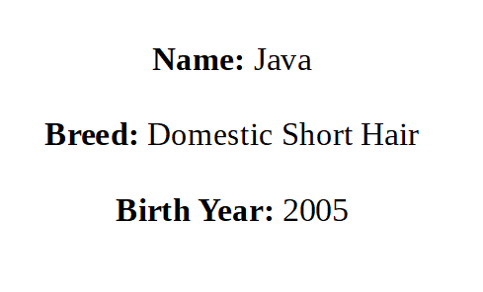
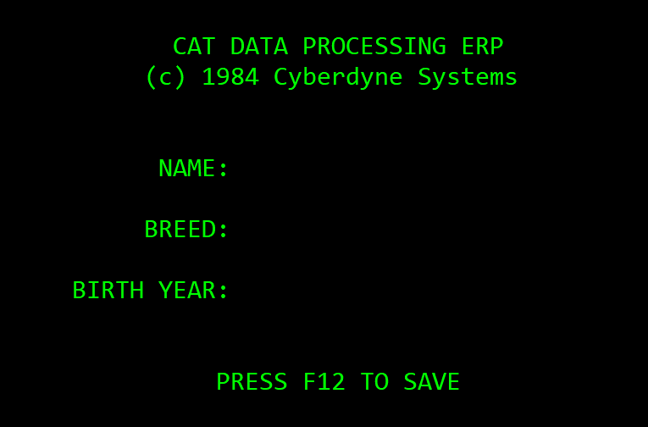
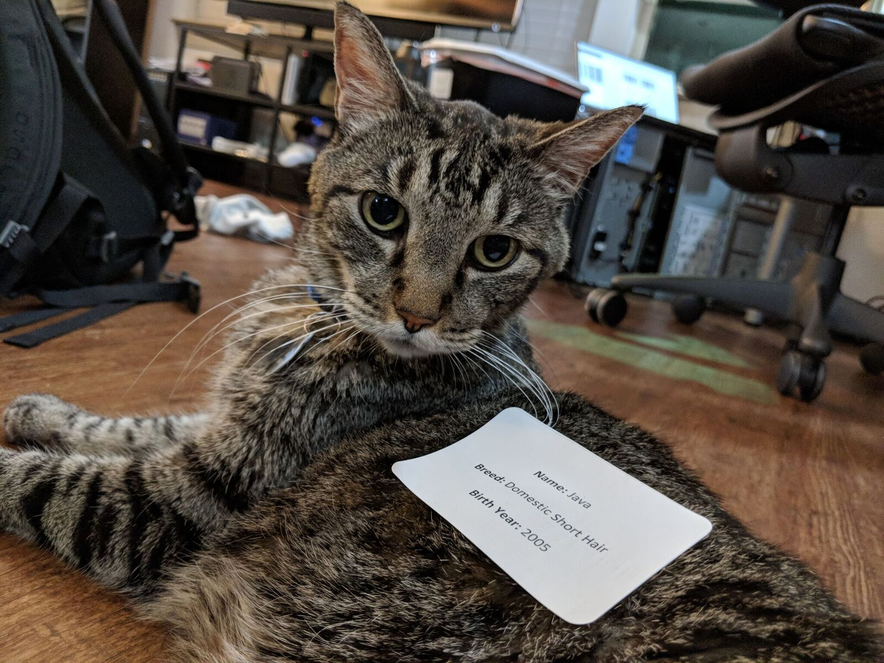
Herding cats

Slide 13

Herding cats

Slide 14
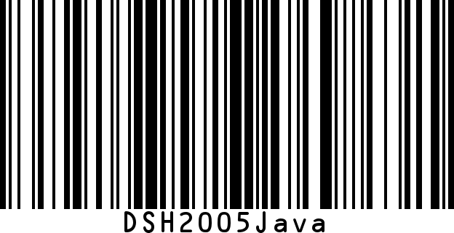
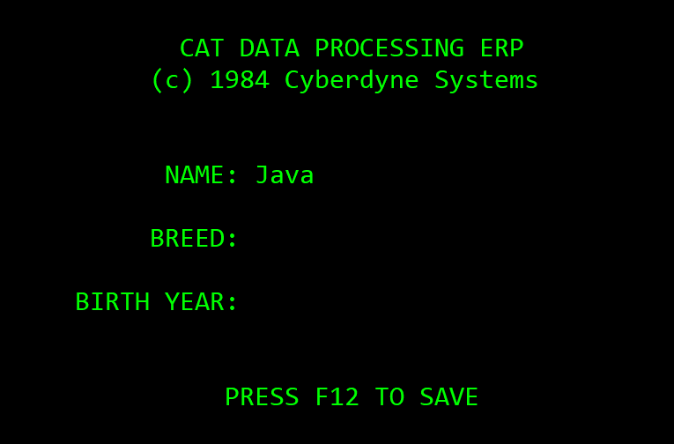
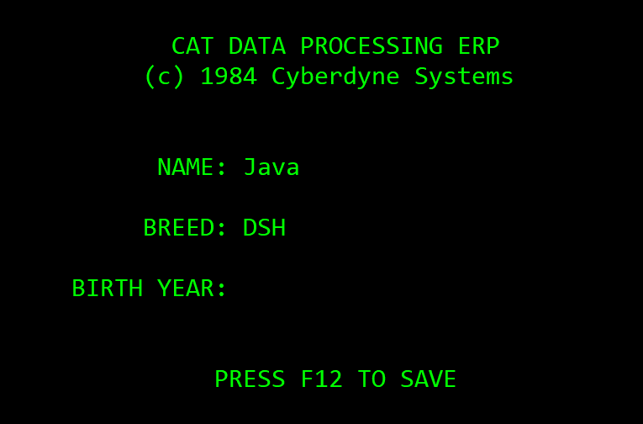
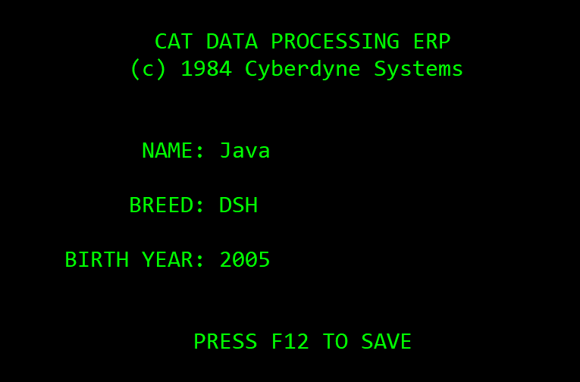

Barcoding cats
Cursor
Cursor
Cursor
Cursor
+ <tab>
+ F12

Slide 15
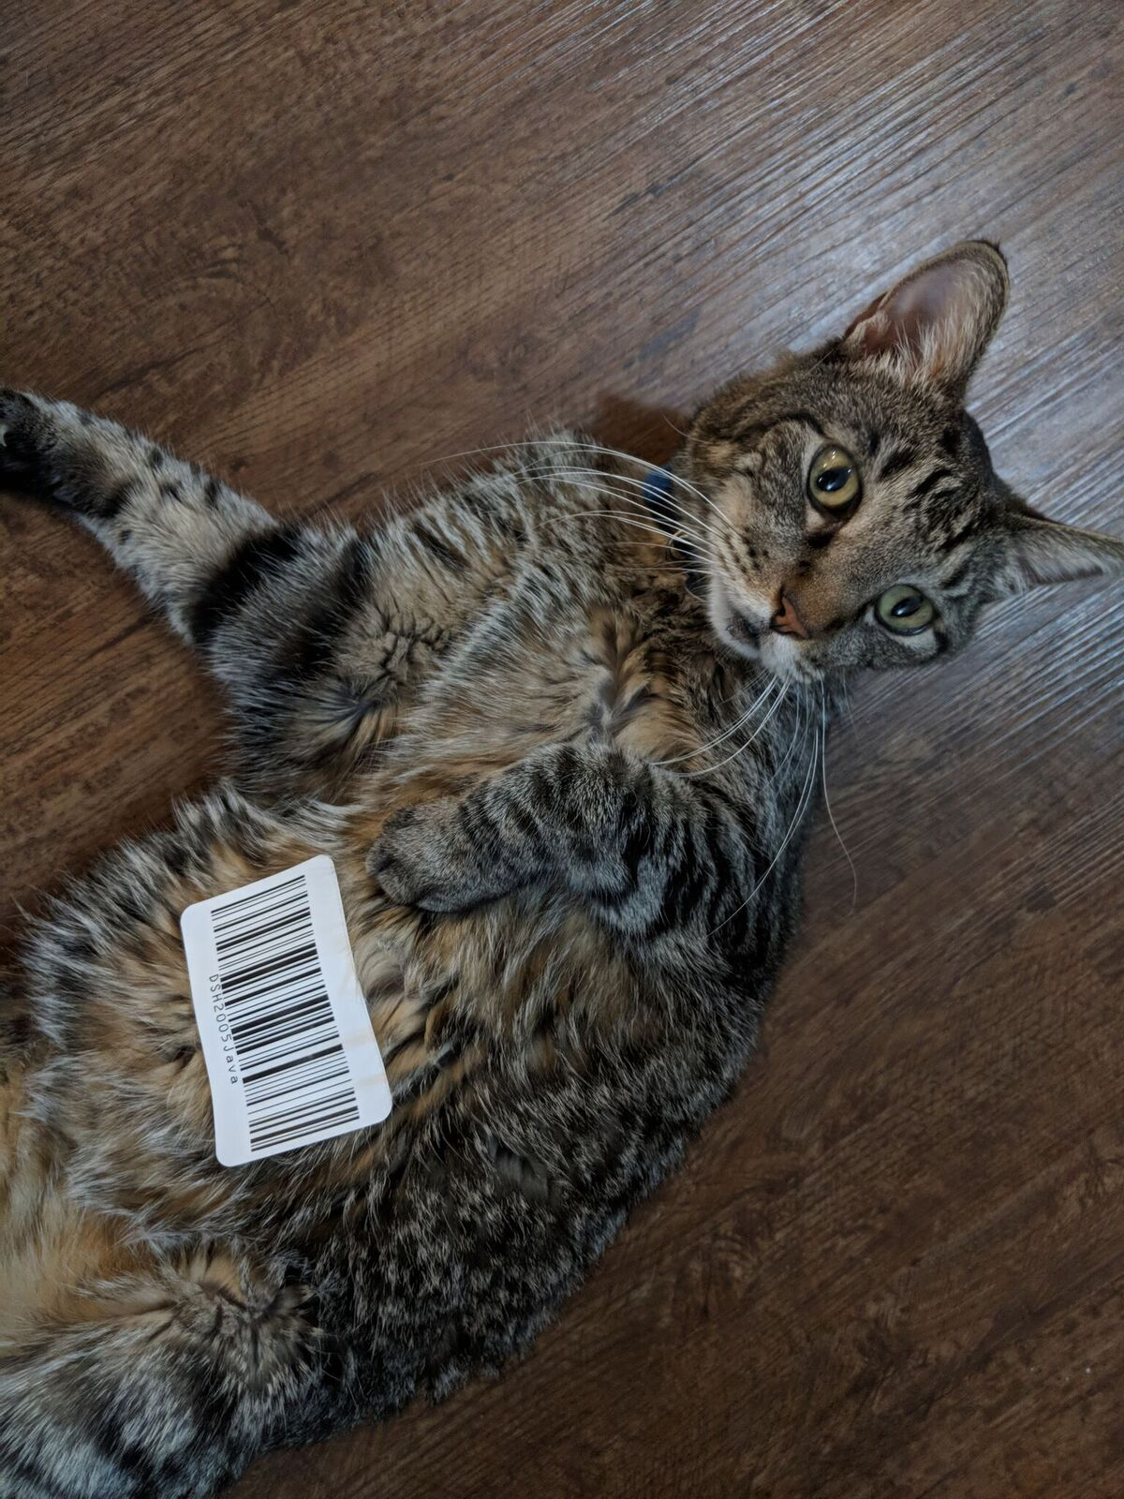
Scanning cats

Slide 16
Scanning cats

Slide 17

Programming is stupid simple
Specify criteria
All barcodes (no criteria)
Barcodes that start with 9
Barcodes that contain "cat"
All UPC barcodes
Specify actions when rule is triggered
Can store multiple rules
Model-specific limits on size
"CatERP"

Slide 18
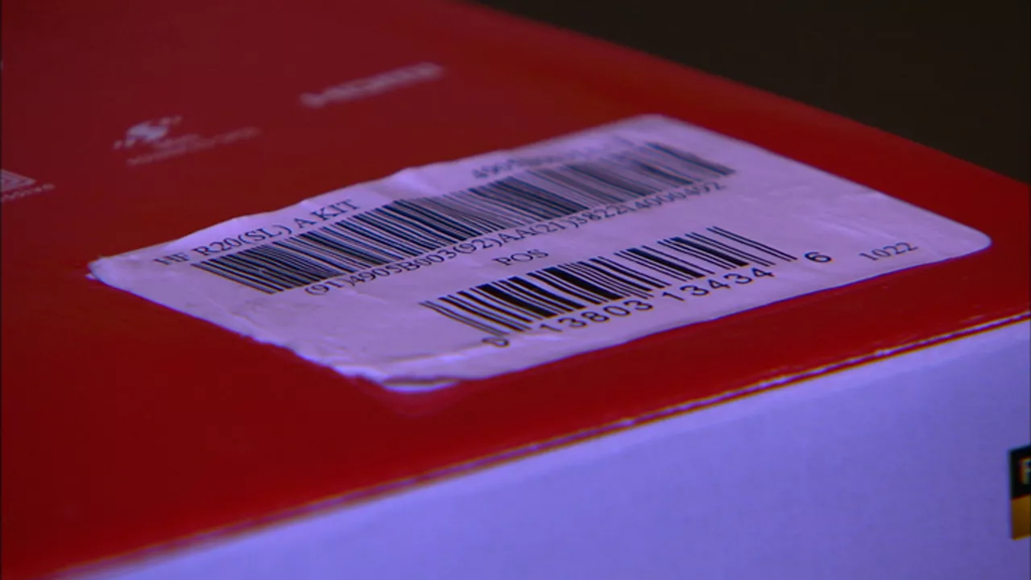
Actions we can do with rules
Modify/replace text
Ignore text
Add extra characters
Add special keys
Ctrl or Alt key combos
Windows/super key too!
"Brick" scanners
Do nothing!

Slide 19
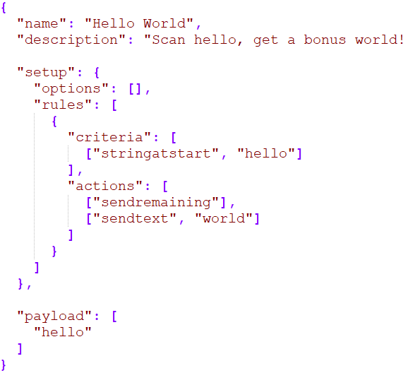
barcOwned (finally)
Payload design IDE
Payloads in JSON
Rapidly develop and test
Abstracts most complexity
No deciphering manuals
Supports Motorola Symbol
Send us scanners?
Open source
Harder Than Ducky Script™

Slide 20
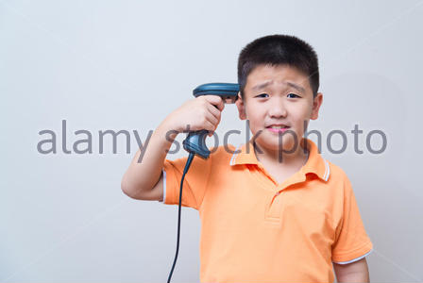
Demo

Slide 21
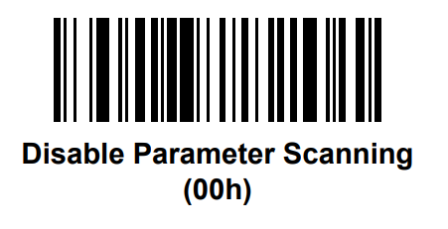
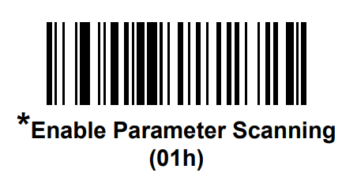
Can you turn it off?

Slide 22
Red team considerations
Find beeper hole and cover it if possible
Successful attacks take significant recon, planning
BYOS - Bring Your Own Scanner
Detach scanner with screwdriver, plug your own in
Even when systems are off, scanners may be powered
Laser scanners will only work with paper or a Kindle
Trick others into delivering barcodes

Slide 23
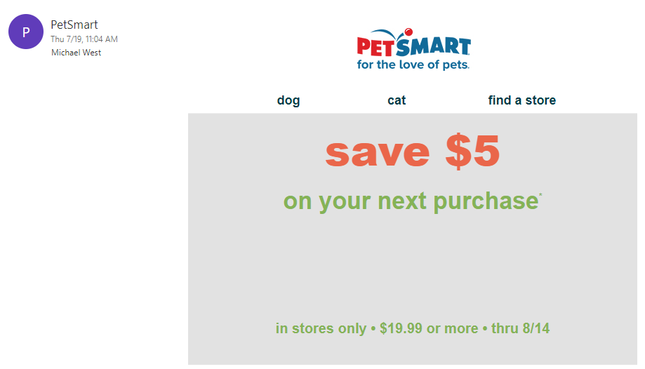
Let someone else do the dirty work

Slide 24
Blue team considerations
No way to secure scanners from programming
Some models may not support it
Assume scanners are hostile keyboards
Remove local admin
Use endpoint protection + app control
Limit PowerShell, cmd, run dialog, etc
Filter malicious keys at OS-level
Or enforce non-HID modes

Slide 25
Related talks
BadBarcode - Yang Yu
PacSec 2015 in Tokyo
Demoed attack, no paper/code released
Toying with Barcodes - Felix Lindner
DEF CON 16 in 2008
General overview of barcodes as input vectors

Slide 26

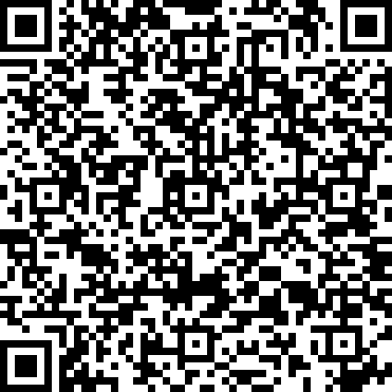
Special thanks
Terry Burton - BWIPP
Mark Warren - bwip-js
Hermit Hacker - shirts
Dallas Hackers Association
CyberArk - travel + support

Slide 27
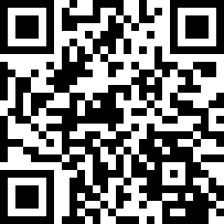
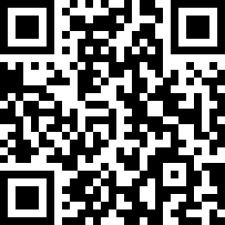
barcowned.com
github.com/t3hub3rk1tten/barcowned
Michael West @t3hub3rk1tten mwe.st
Colin Campbell @magicspacekiwi

